Slide 1

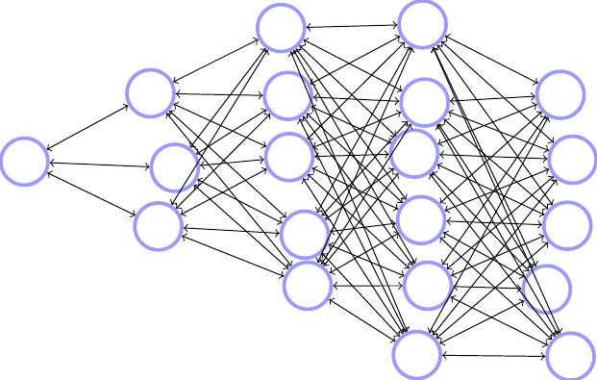
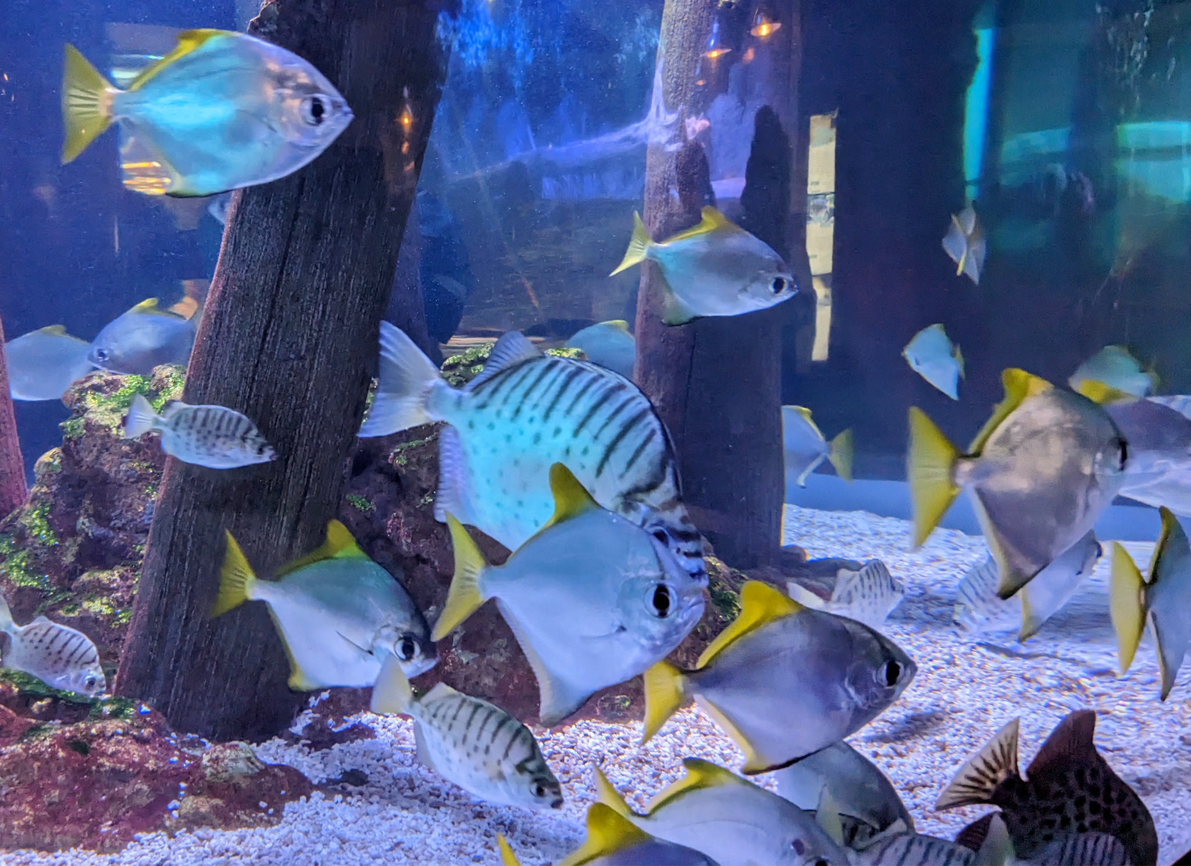
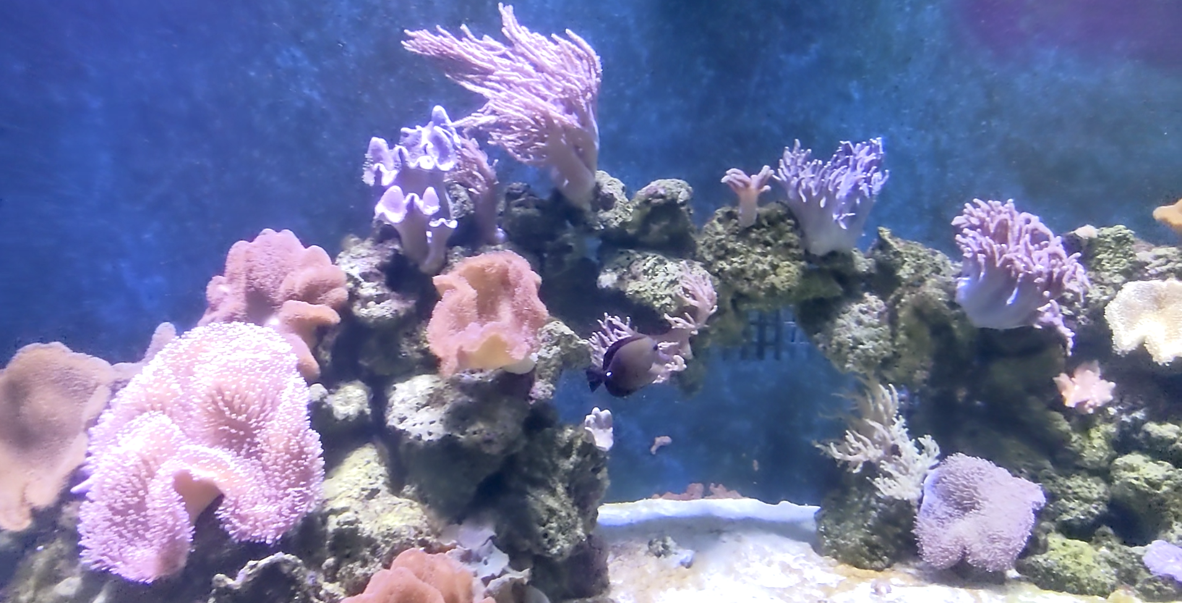
Bayes, Brain, and Fish
Nan Ye
CBCS Seminar, 11 July

Slide 2



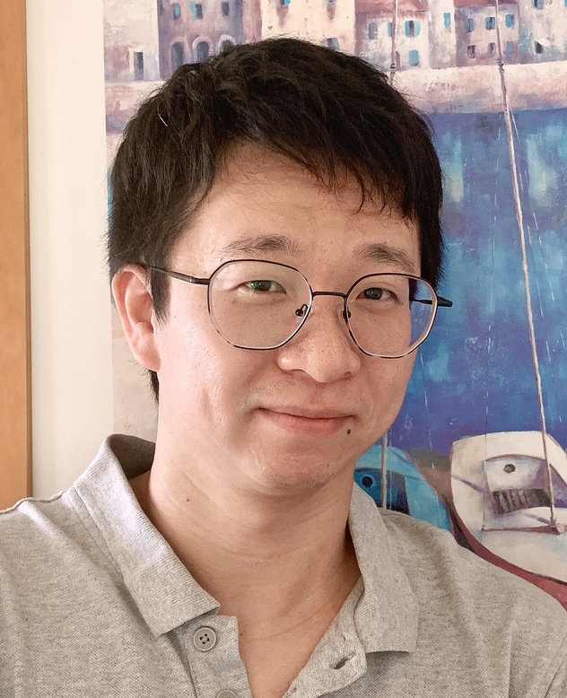
Managing fisheries is hard: it’s like managing a forest, in which the trees are invisible and keep moving around.
John Shepherd
Our project: Estimate fish abundance and management reference points
Notes:
Artificial Intelligence and Machine Learning is one of the future science platforms in CSIRO Oceans and Atmosphere Strategy Overview 2021-24.

Slide 3





Catch and effort
Our Methods
Catch-Per-Unit-Effort (CPUE) Standardization
Use artificial neural nets (ANNs) for catch rate prediction
Enforce dependency structure based on prior knowledge
Standardized catch rates
Stock assessment
Robust Bayesian approach
Automatically adjust the importance of the prior based on its quality
Abundance
Notes:
https://emojipedia.org/motor-boat/
[TODO: informally introduce the problem, perhaps combine with the next slide]
Quantitative stock assessment and modelling of fisheries are essential for informed decisions in sustainable fisheries management. However, constructing reliable assessment models to achieve accurate estimation of population parameters remains a key challenge after more than half a century of active research.
The difficulty stems from various sources, including our lack of precise knowledge of the fishery dynamics, the complexity of relationships between variables of interest, the high-dimensionality of fisheries data, presence of noisy and missing values.

Slide 4
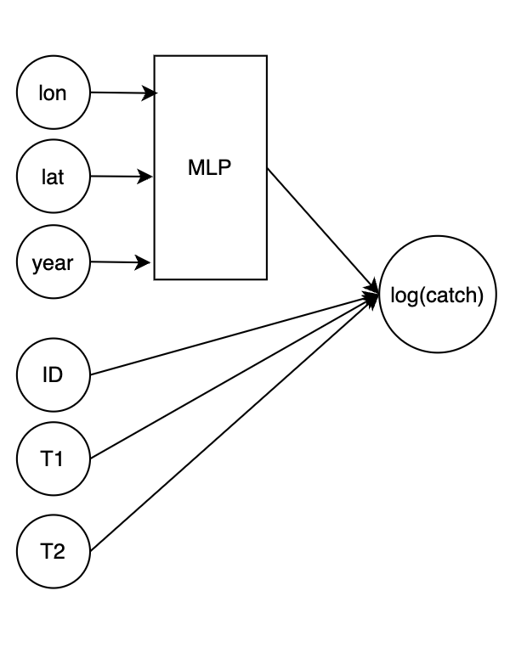
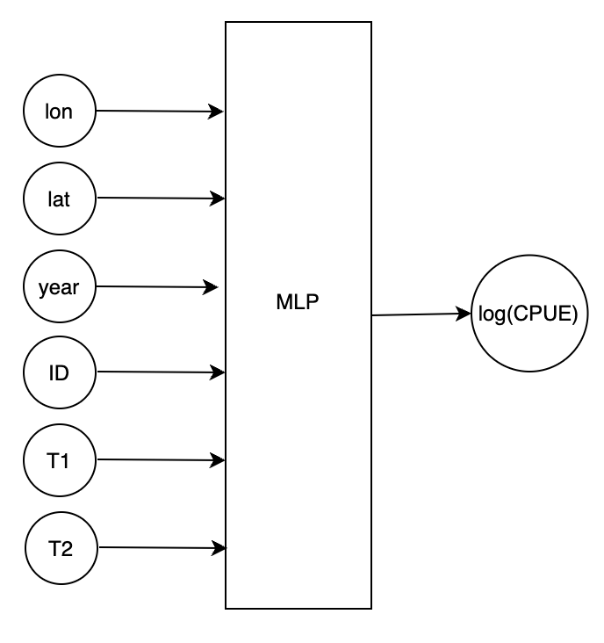
Spatial-temporal ANNs for CPUE Standardization
ANNs: brain-inspired, interconnected simple computational units, expressive
Two approaches
Full-ANN (typical)
ST-ANN (ours)
Full-ANN: no prior knowledge log(catch) ~ f(lat, lon, yr, boat_ID, tech_1, tech_2)
ST-ANN: exploit prior knowledge on dependency structure log(catch) ~ f(lat,lon,yr) + boat_ID + tech_1 + tech_2

Slide 5
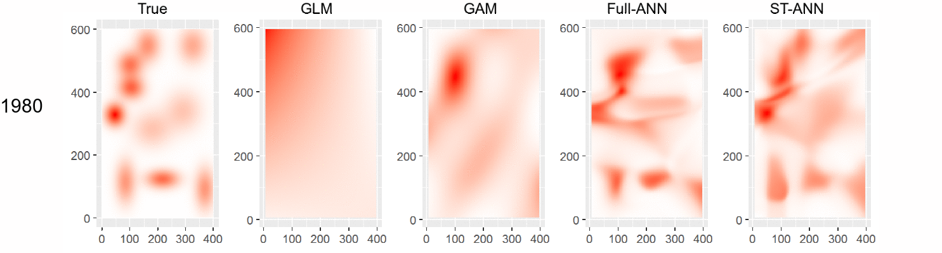
CPUE Standardization on Simulation Data
Data generation
Highly migratory species
Fishing sites initially random but become concentrated around the high-density regions over time due to technology upgrades
Catch affected by technology: tech_1 (increased catchability), tech_2 (increased fishing area)
Models
GLM: log(catch) ~ lat*lon*yr + boat_ID + tech_1 + tech_2
GAM: log(catch) ~ te(lat,lon,yr) + boat ID + tech_1 + tech_2
ST-ANN: log(catch) ~ f(lat,lon,yr) + boat_ID + tech_1 + tech_2
Full-ANN: log(catch) ~ f(lat, lon, yr, boat_ID, tech_1, tech_2)

Slide 6
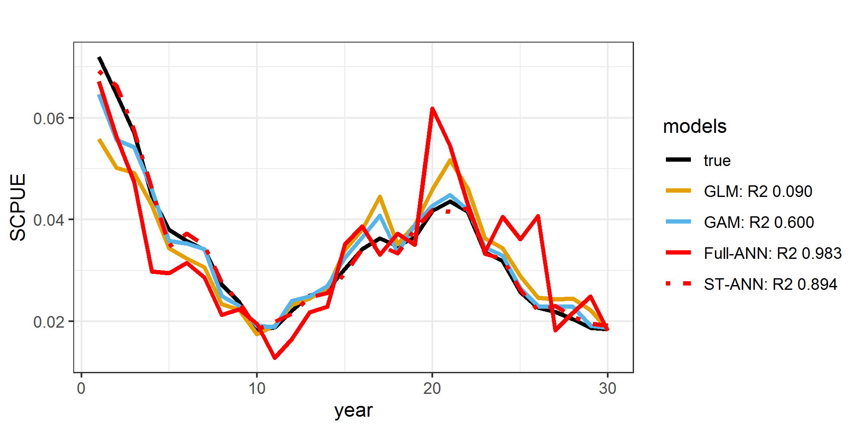
Species distribution
SCPUEs
ANN models are best at modelling the spatial-temporal distribution
ST-ANN is more accurate than Full-ANN
Full-ANN has best R2, worst SCPUE
ST-ANN has 2nd best R2, best SCPUE

Slide 7
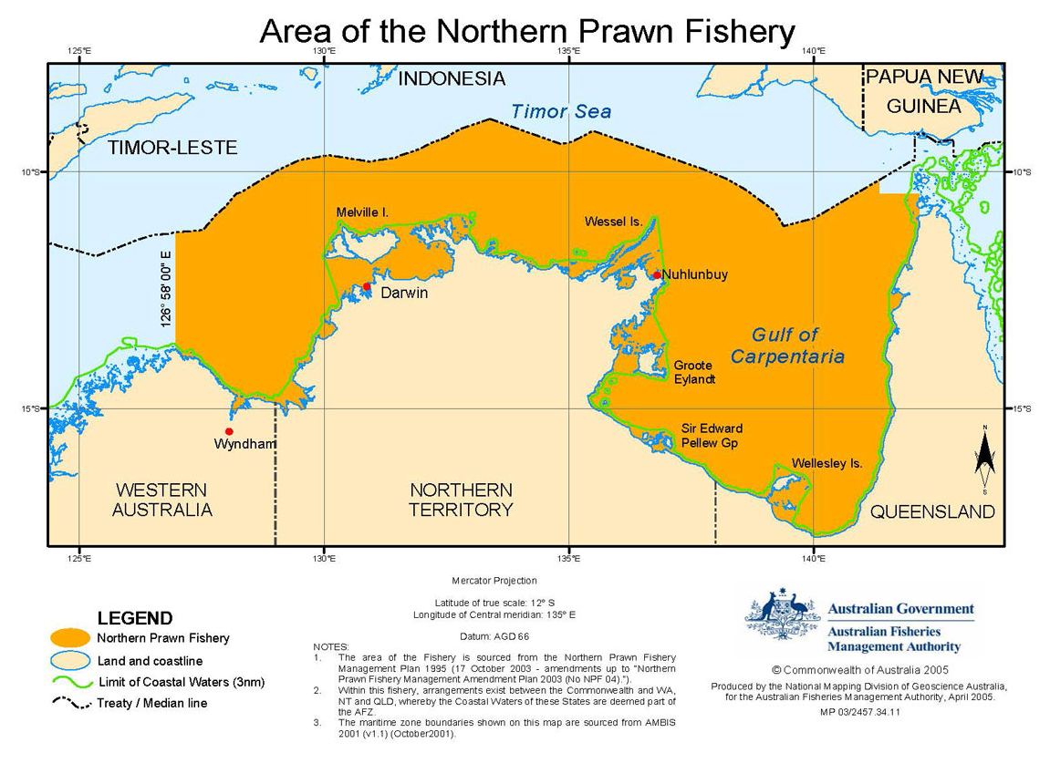
Northern Prawn Fishery CPUE Standardization
Species: endeavour prawn
Catch and effort data from 1970 to 2020
680,589 records of daily vessel specific fishing activities
Source: https://www.afma.gov.au/fisheries/northern-prawn-fishery

Slide 8
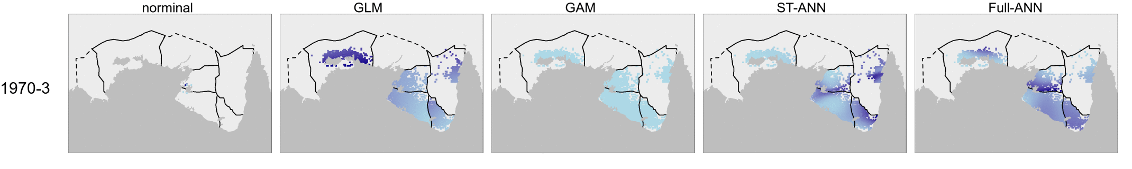
Models
GLM: C ~ year* cday + tiger.region* cday + month + impl1.hours + lon* lat + trygear + plotter + pc.sat + echocol + hullg + nav.accg + log(depth) + log(prop.semi) + log(local.tiger.ef fort) + log(satig) + log(nVcode) + b. spline(cday, 6)
GAM: C ~ year* cday + tiger.region* cday + month + s(impl1.hours) + te (lon, lat) + trygear + plotter + pc.sat + echocol+ hullg + nav.accg + s(depth) + s(prop.semi) + s(localtiger.ef fort) + s(satig) + s(nVcode) + s(cday)
Full-ANN: C ~ f(year,cday, tiger.region,month,impl1.hours,lon, lat,trygear,plotter,pc.sat, echocol, hullg, nav.accg, depth, prop.semi, localtiger.effort, satig, vcode)
ST-ANN: C ~ f(lon, lat,year,month,depth) + f(trygear,plotter,pc.sat ,echocol,hullg, nav.accg, vcode) + impl1.hours
Species distribution

Slide 9
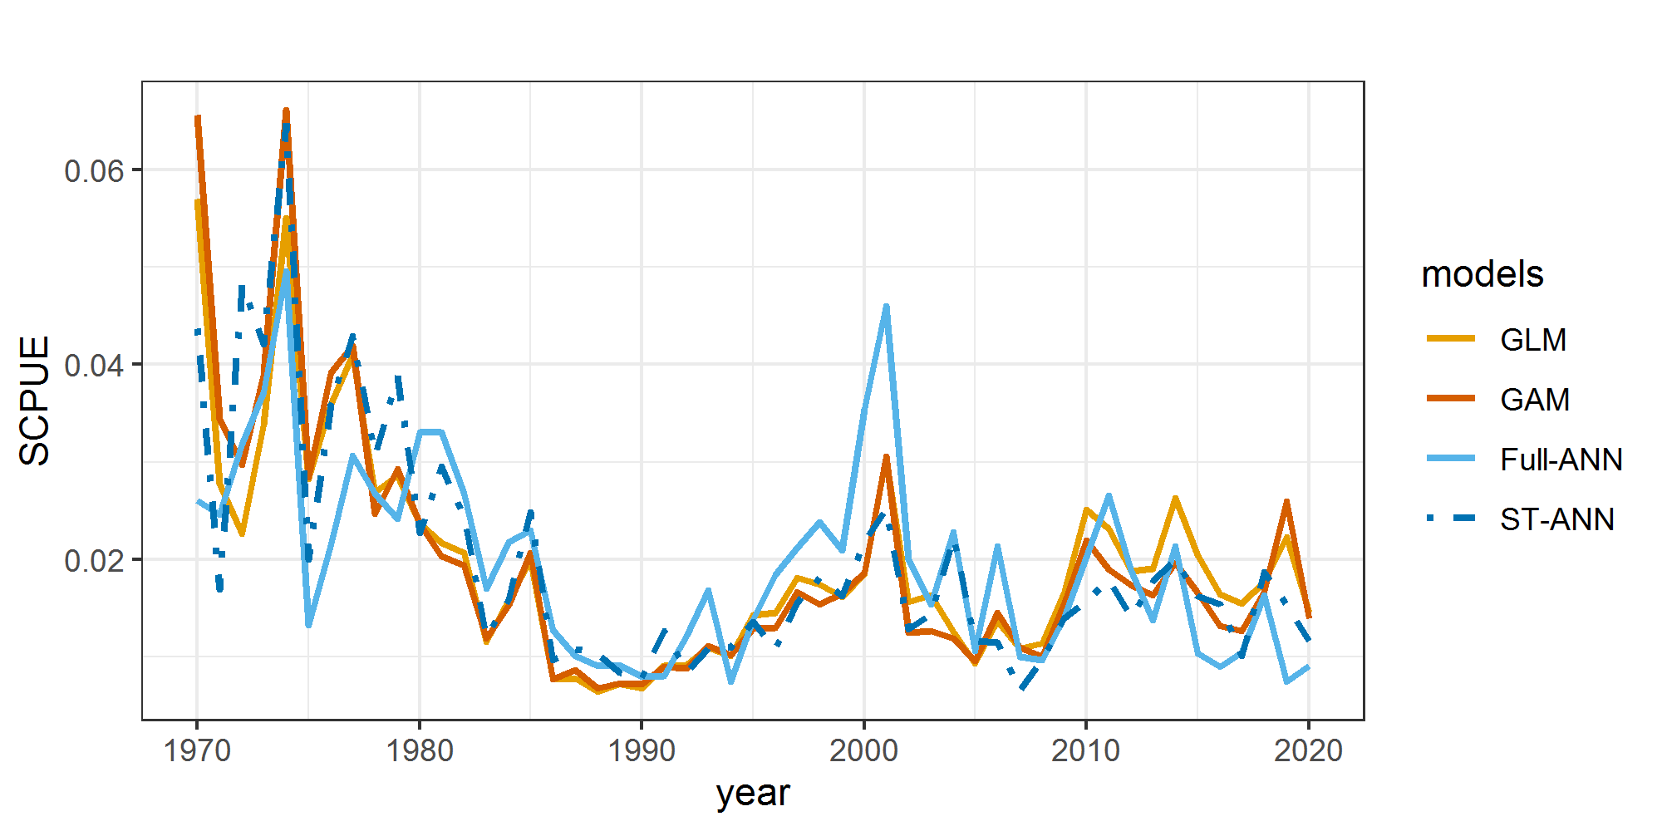
SCPUEs

Slide 10
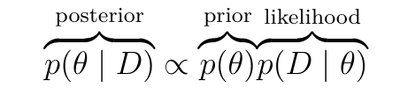

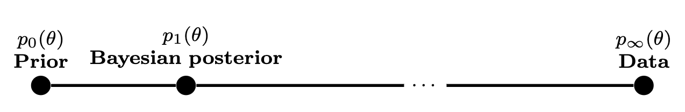

Robust Bayesian Stock Estimation
Standard Bayesian estimation
MBE (Multi-pass Bayesian Estimation): construct a sequence of posterior distributions by repeated Bayesian updates with the given data, then automatically pick the best one
Poorly chosen priors => poor inference results.
<- prior more important
data more important ->
Prior’s influence depends on its quality.

Slide 11
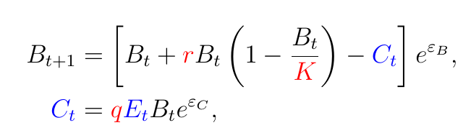
Stock Assessment on Simulation Data
Data generation
Observed: catches C and efforts E
Stock parameters: K (carrying capacity), r (intrinsic population growth rate), q (catchability), ψ (initial depletion)
Stock assessment is based on the same model (in a slightly different form).

Slide 12
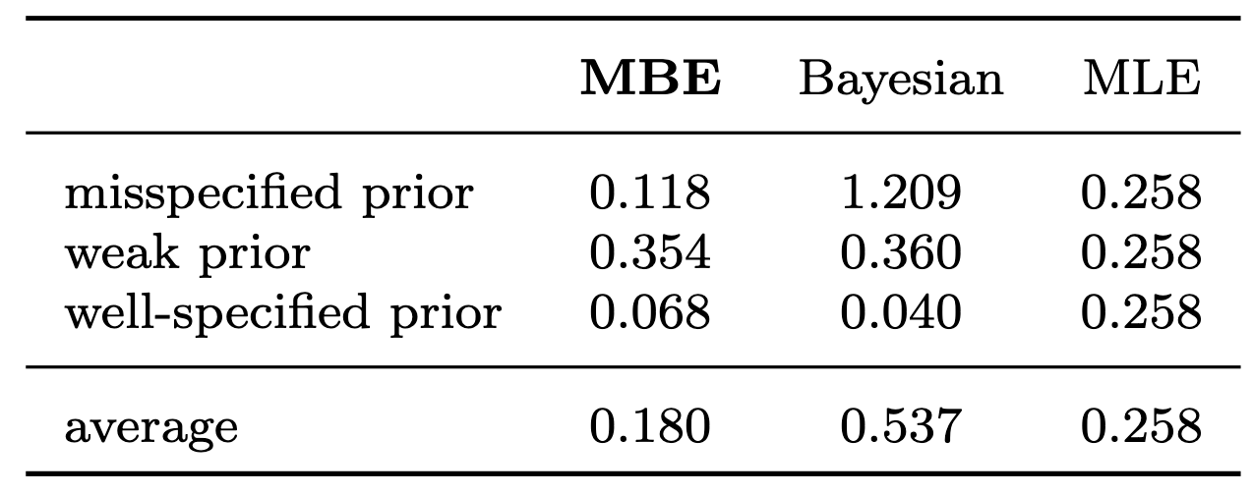
100 random datasets with 30 observations each, different prior qualities
Quality of estimates
Average absolute relative error over all parameter estimates and all datasets

Slide 13
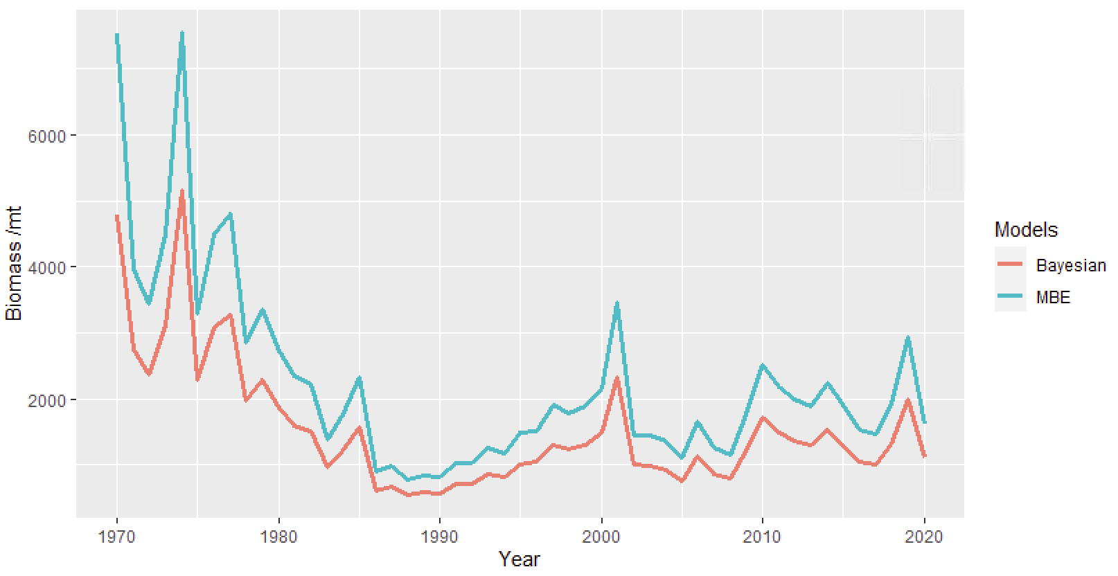
NPF Stock Assessment
Stock parameters and management reference points
Estimated stock sizes
 | K/mt | r | q | ψ | MSY/mt | FMSY | BMSY/mt
Standard Bayesian | 4,778.0 | 0.737 | 1.1e-8 | 1 | 880.3 | 0.369 | 2,389.0
MBE | 7,543.0 | 0.342 | 3.5e-9 | 1 | 644.9 | 0.171 | 3,771.5t

Slide 14
Catch and effort
Bayes, Brain, and Fish…
Our Methods
Catch-Per-Unit-Effort (CPUE) Standardization
Use artificial neural nets (ANNs) for catch rate prediction
Enforce dependency structure based on prior knowledge
Standardized catch rates
Stock assessment
Robust Bayesian approach
Automatically adjust the importance of the prior based on its quality
Abundance
Numerical results show that they are promising.
Notes:
https://emojipedia.org/motor-boat/
[TODO: informally introduce the problem, perhaps combine with the next slide]
Quantitative stock assessment and modelling of fisheries are essential for informed decisions in sustainable fisheries management. However, constructing reliable assessment models to achieve accurate estimation of population parameters remains a key challenge after more than half a century of active research.
The difficulty stems from various sources, including our lack of precise knowledge of the fishery dynamics, the complexity of relationships between variables of interest, the high-dimensionality of fisheries data, presence of noisy and missing values.

